Slide 1














Travel List
Gözde Akgün

Slide 2
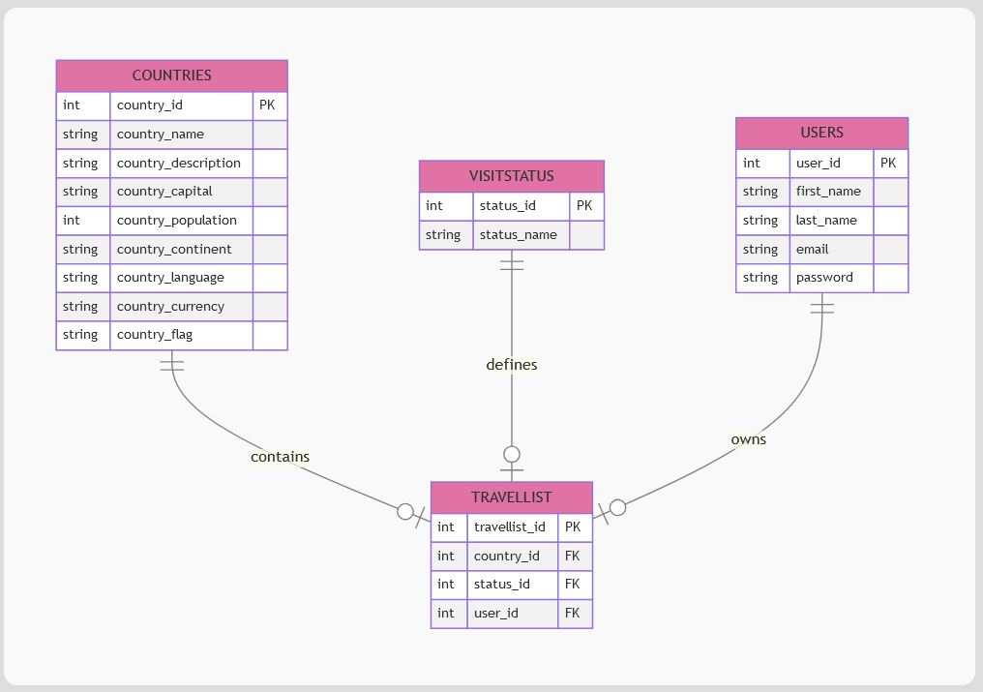
STRUKTUR
HOOK för statik Countries Tabell
RestCountries API
WikiPedia API
Countries.json {}

Slide 3
Privat Repo- ChangeLog /Rapport
Login- Register- TravelList (CRUD)
BACKEND
PostgreSQL -dotenv - pg
Node.js- Nodemon
Express - Cors
Json webtoken
Typescript
File System -fs
DOCKER COMPOSE
DATABASE ER DIAGRAM
FRONTEND
Typescript - React - Vite
React. Bootstrap - Icon - Router -Lazy- preload
Formik- Yup --validation
Leaflet --karta
Axios
TESTS
Cypress TDD - Komplett E2E- Component
Cucumber - BDD + TDD
Code Coverage
GitHub Actions

Slide 4
Tack så mycket!

